Slide 1

CHAPTER 8
PROPERTIES OF RELATIONS
Copyright © Cengage Learning. All rights reserved.

Slide 2

8.3
Equivalence Relations
Copyright © Cengage Learning. All rights reserved.

Slide 3
The Relation Induced by a Partition

Slide 4
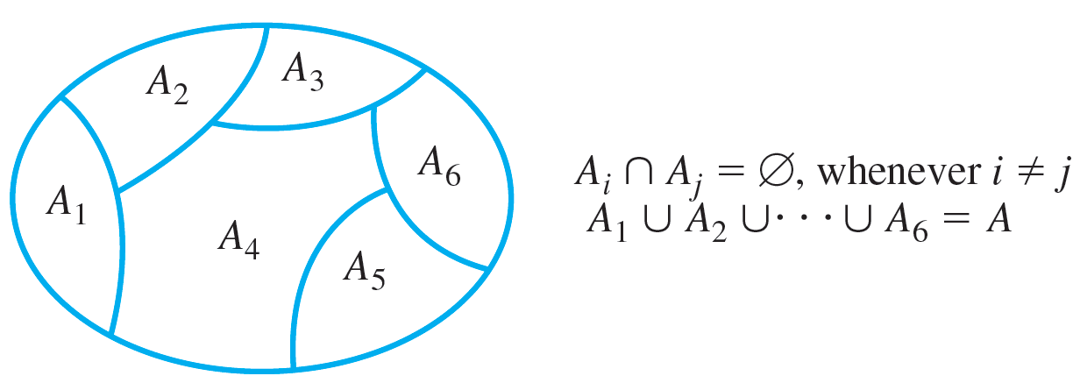
The Relation Induced by a Partition
A partition of a set A is a finite or infinite collection of nonempty, mutually disjoint subsets whose union is A. The diagram of Figure 8.3.1 illustrates a partition of a set A by subsets A₁, A₂, … , A₆.
A Partition of a Set
Figure 8.3.1

Slide 5
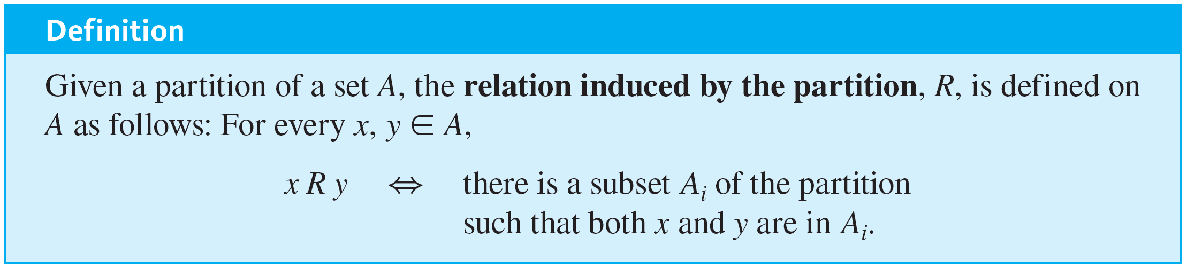
The Relation Induced by a Partition

Slide 6
Example 8.3.1 – Relation Induced by a Partition
Let A = {0, 1, 2, 3, 4} and consider the following partition of A:
{0, 3, 4}, {1}, {2}.
Find the relation R induced by this partition.

Slide 7
Example 8.3.1 – Solution
Since {0, 3, 4} is a subset of the partition,
0 R 3 because both 0 and 3 are in {0, 3, 4}
3 R 0 because both 3 and 0 are in {0, 3, 4}
0 R 4 because both 0 and 4 are in {0, 3, 4}
4 R 0 because both 4 and 0 are in {0, 3, 4}
3 R 4 because both 3 and 4 are in {0, 3, 4}
and
4 R 3 because both 4 and 3 are in {0, 3, 4}.

Slide 8
Example 8.3.1 – Solution
continued
Also,
0 R 0 because both 0 and 0 are in {0, 3, 4}
3 R 3 because both 3 and 3 are in {0, 3, 4}
and
4 R 4 because both 4 and 4 are in {0, 3, 4}.

Slide 9
Example 8.3.1 – Solution
continued
Since {1} is a subset of the partition,
1 R 1 because both 1 and 1 are in {1},
and since {2} is a subset of the partition,
2 R 2 because both 2 and 2 are in {2}.
Hence
R = {(0, 0), (0, 3), (0, 4), (1, 1), (2, 2), (3, 0), (3, 3), (3, 4), (4, 0), (4, 3), (4, 4)}.

Slide 10
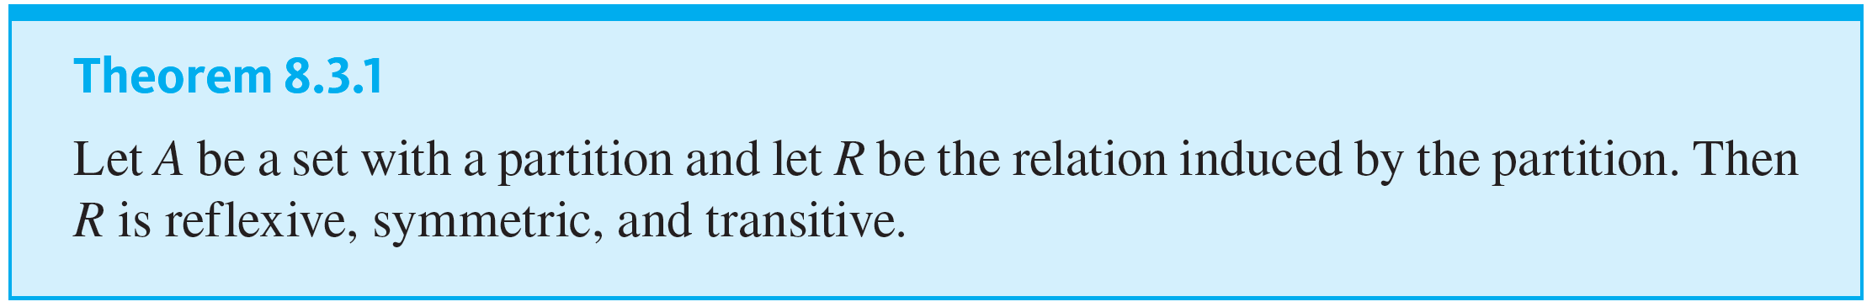
The Relation Induced by a Partition

Slide 11
Definition of an Equivalence Relation

Slide 12
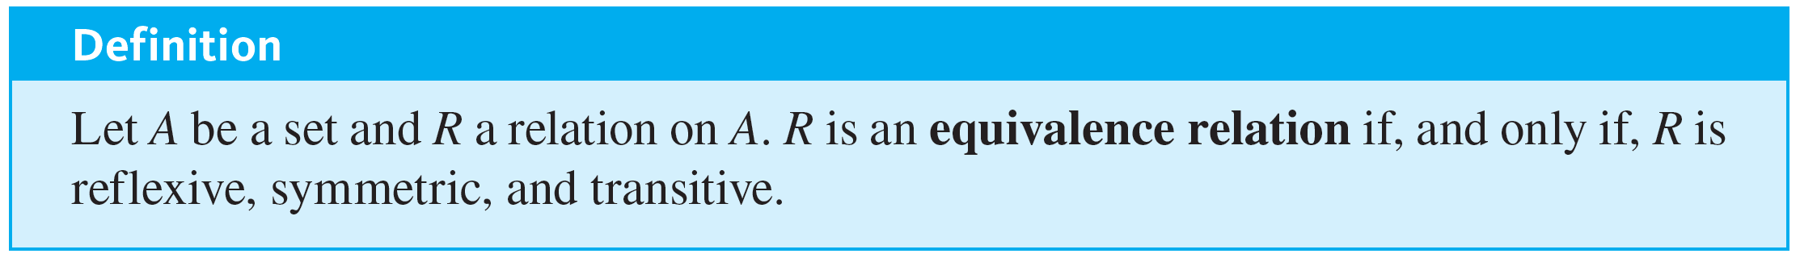
Definition of an Equivalence Relation
A relation on a set that satisfies the three properties of reflexivity, symmetry, and transitivity is called an equivalence relation.

Slide 13
Example 8.3.2 – An Equivalence Relation on a Set of Subsets
Let X be the set of all nonempty subsets of {1, 2, 3}. Then
X = {{1}, {2}, {3}, {1, 2}, {1, 3}, {2, 3}, {1, 2, 3}}.
Define a relation R on X as follows: For every A and B in X,
A R B ⇔ the least element of A equals the least
element of B.
Prove that R is an equivalence relation on X.

Slide 14
Example 8.3.2 – Solution
R is reflexive: Suppose A is a nonempty subset of {1, 2, 3}. [We must show that A R A.] It is true to say that the least element of A equals the least element of A. Thus, by definition of R, A R A.
R is symmetric: Suppose A and B are nonempty subsets of {1, 2, 3} and A R B. [We must show that B R A.] Since A R B, the least element of A equals the least element of B. But this implies that the least element of B equals the least element of A, and so, by definition of R, B R A.

Slide 15
Example 8.3.2 – Solution
continued
R is transitive: Suppose A, B, and C are nonempty subsets of {1, 2, 3}, A R B, and B R C. [We must show that A R C.] Since A R B, the least element of A equals the least element of B and since B R C, the least element of B equals the least element of C.
Thus the least element of A equals the least element of C, and so, by definition of R, A R C.

Slide 16
Equivalence Classes of an Equivalence Relation

Slide 17
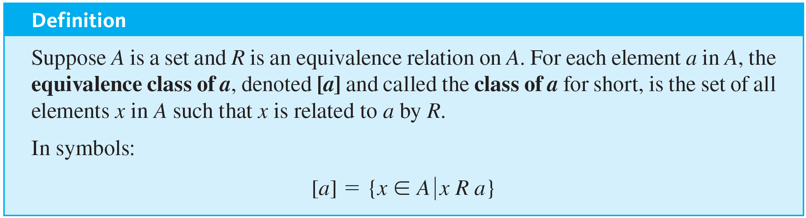
Equivalence Classes of an Equivalence Relation
Suppose there is an equivalence relation on a certain set. If a is any particular element of the set, then one can ask, “What is the subset of all elements that are related to a?” This subset is called the equivalence class of a.

Slide 18

Equivalence Classes of an Equivalence Relation
The procedural version of this definition is
The notation [a]_{R} may be used to denote the equivalence class of a for the relation R.

Slide 19
Example 8.3.5 – Equivalence Classes of a Relation Given as a Set of Ordered Pairs
Let A = {0, 1, 2, 3, 4} and define a relation R on A as follows:
R = {(0, 0), (0, 4), (1, 1), (1, 3), (2, 2), (3, 1), (3, 3),
(4, 0), (4, 4)}.

Slide 20
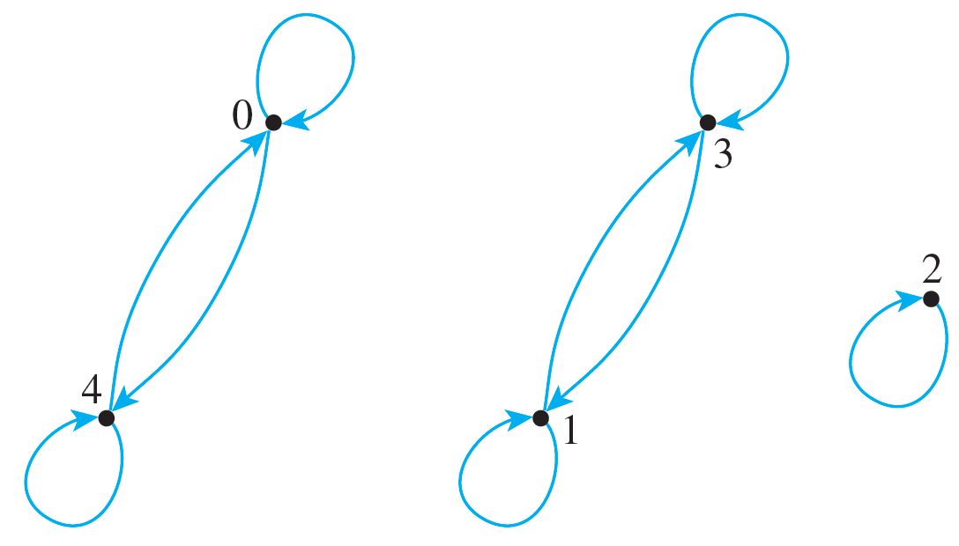
Example 8.3.5 – Equivalence Classes of a Relation Given as a Set of Ordered Pairs
continued
The directed graph for R is as shown below. As can be seen by inspection, R is an equivalence relation on A. Find the distinct equivalence classes of R.

Slide 21
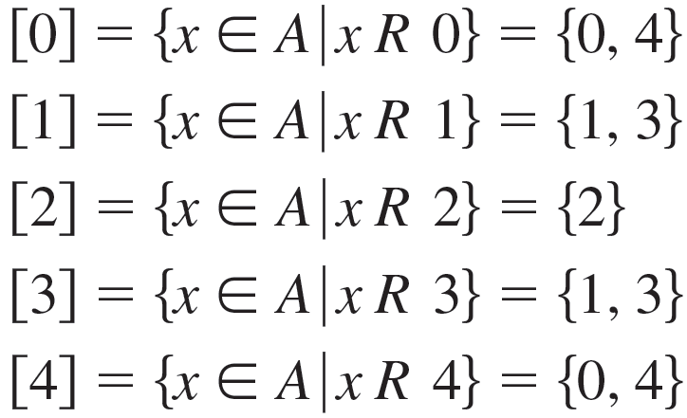
Example 8.3.5 – Solution
First find the equivalence class of every element of A.
Note that [0] = [4] and [1] = [3]. Thus the distinct equivalence classes of the relation are {0, 4}, {1, 3}, and {2}.

Slide 22
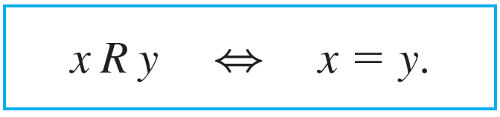
Example 8.3.8 – Equivalence Classes of the Identity Relation
Let A be any set and define a relation R on A as follows: For every x and y in A,
Then R is an equivalence relation. Describe the distinct equivalence classes of R.

Slide 23


Example 8.3.8 – Solution
Given any a in A, the class of a is
Now by definition of R, a R x if, and only if, a = x. So
= [a] since the only element of A that equals a is a.

Slide 24
Example 8.3.8 – Solution
continued
Hence, given any a in A,
[a] = {a},
and if x ≠ a then {x} ≠ {a}.
Consequently, all the classes of all the elements of A are distinct, and the distinct equivalence classes of R are all the single-element subsets of A.

Slide 25
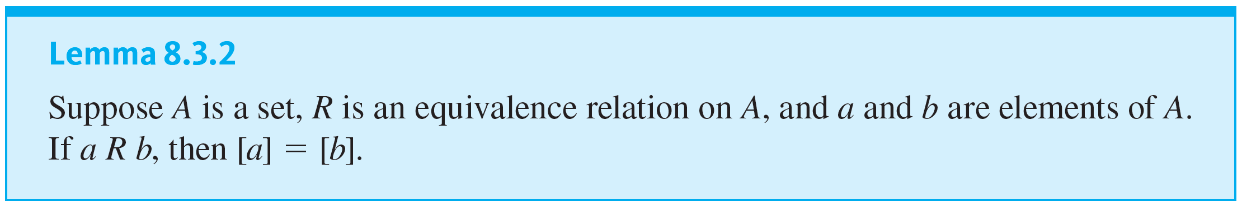
Equivalence Classes of an Equivalence Relation
The first lemma says that if two elements of A are related by an equivalence relation R, then their equivalence classes are the same.

Slide 26
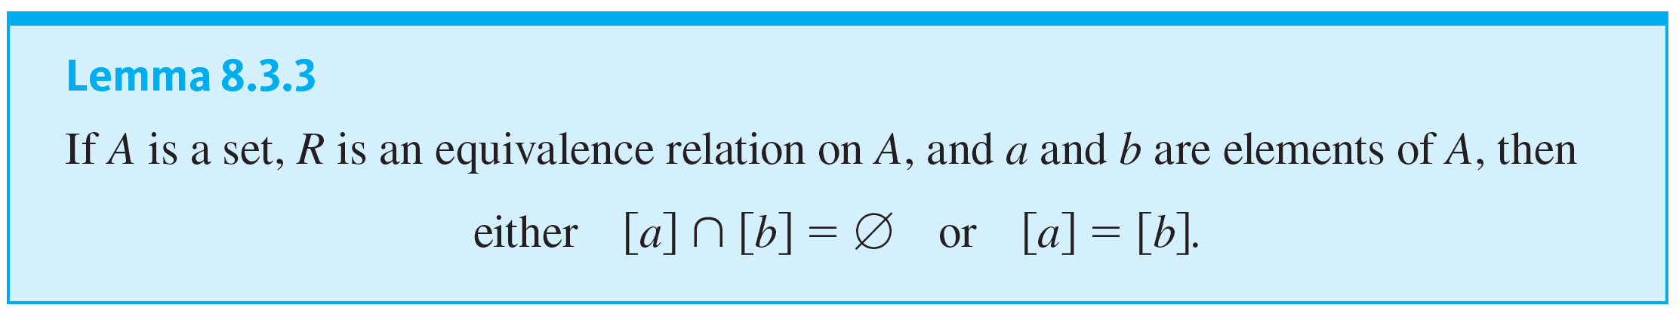
Equivalence Classes of an Equivalence Relation
The second lemma says that any two equivalence classes of an equivalence relation are either mutually disjoint or identical.

Slide 27
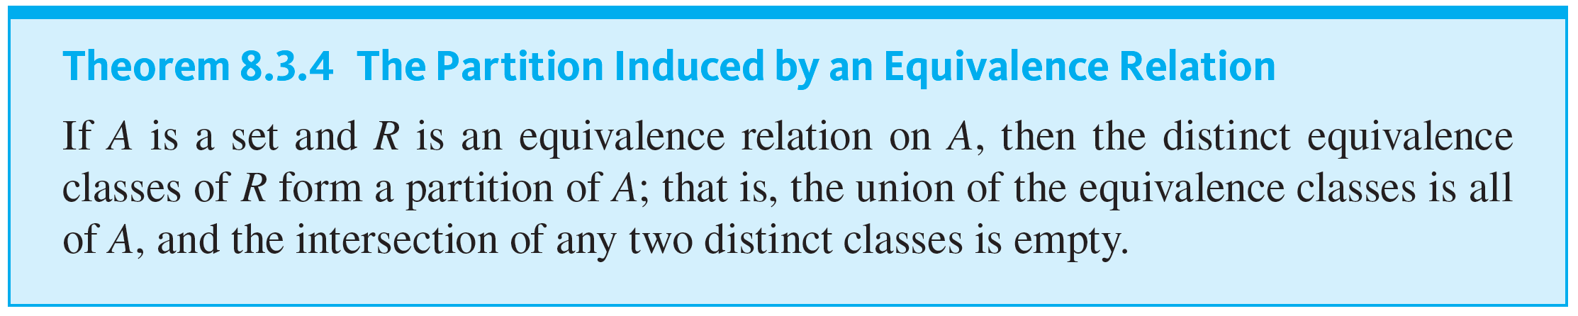
Equivalence Classes of an Equivalence Relation

Slide 28
Congruence Modulo n

Slide 29
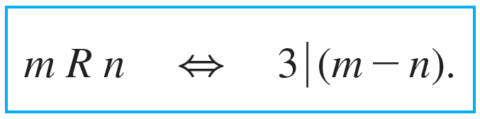
Example 8.3.10 – Equivalence Classes of Congruence Modulo 3
Let R be the relation of congruence modulo 3 on the set Z of all integers. That is, for all integers m and n,
Describe the distinct equivalence classes of R.

Slide 30
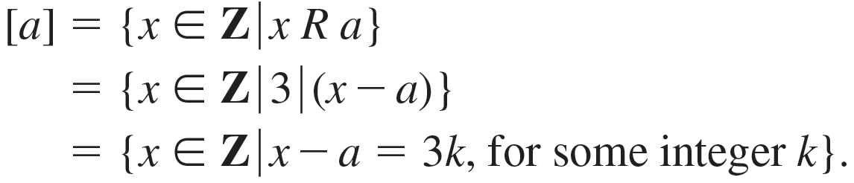
Example 8.3.10 – Solution
For each integer a,
Therefore,

Slide 31
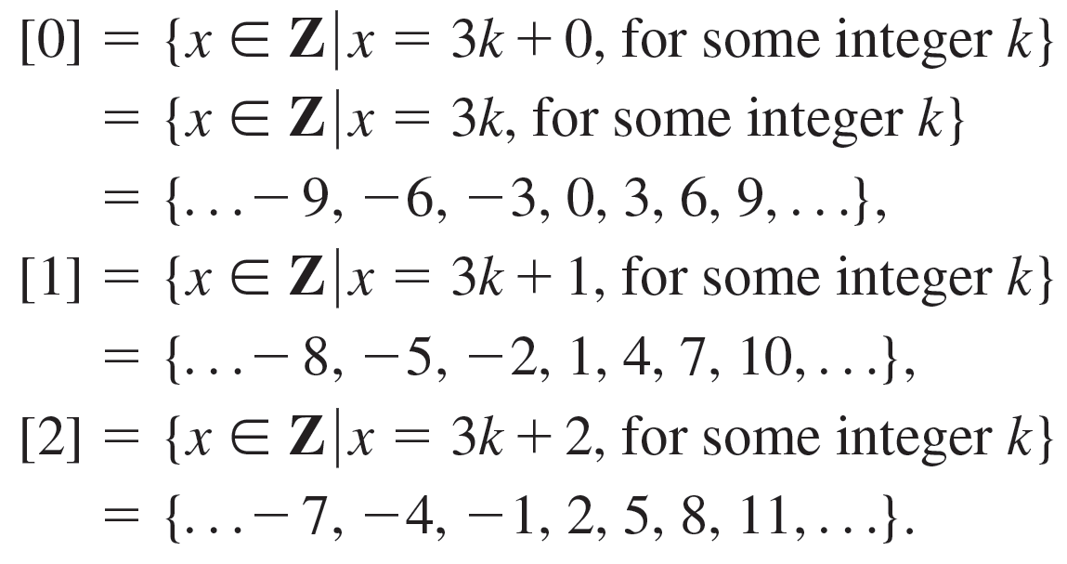
Example 8.3.10 – Solution
continued
In particular,

Slide 32
Example 8.3.10 – Solution
continued
Now since 3 R 0, then by Lemma 8.3.2,
[3] = [0].
More generally, by the same reasoning,
[0] = [3] = [−3] = [6] = [−6] = … , and so on.
Similarly,
[1] = [4] = [−2] = [7] = [−5] = … , and so on.
And
[2] = [5] = [−1] = [8] = [−4] = … , and so on.

Slide 33
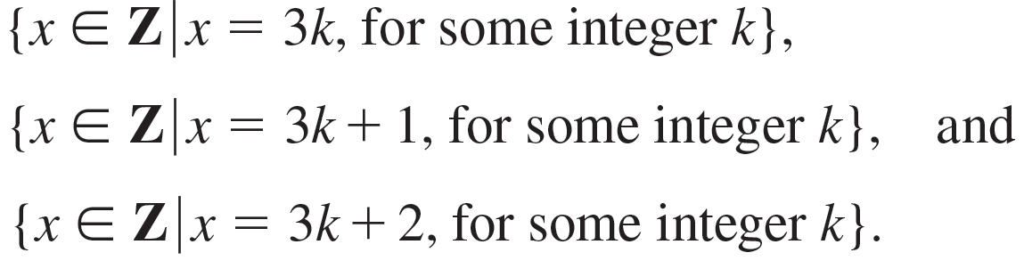
Example 8.3.10 – Solution
continued
Notice that every integer is in class [0], [1], or [2]. Hence the distinct equivalence classes are
In words, the three classes of congruence modulo 3 are (1) the set of all integers that are divisible by 3, (2) the set of all integers that leave a remainder of 1 when divided by 3, and (3) the set of all integers that leave a remainder of 2 when divided by 3.

Slide 34
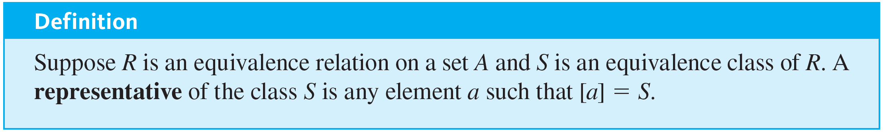
Congruence Modulo n

Slide 35
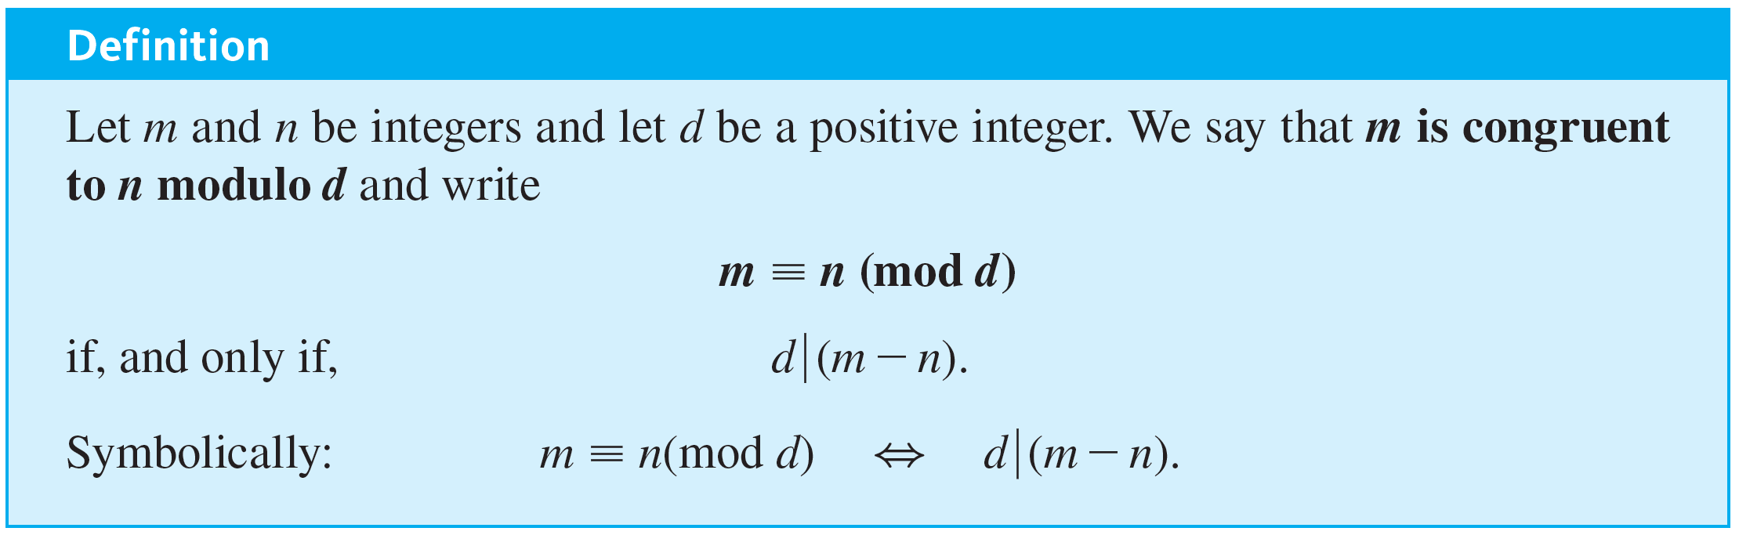
Congruence Modulo n
The following notation is used frequently when referring to congruence relations. It was introduced by Carl Friedrich Gauss in the first chapter of his book Disquisitiones Arithmeticae. This work, which was published when Gauss was only 24, laid the foundation for modern number theory.

Slide 36
Example 8.3.11 – Evaluating Congruences
Determine which of the following congruences are true and which are false.
a. 12 ≡ 7 (mod 5) b. 6 ≡ −8 (mod 4) c. 3 ≡ 3 (mod 7)

Slide 37



Example 8.3.11 – Solution
and so
12 ≡ 7 (mod 5).
b. False. 6 − (−8) = 14, and
a. True. 12 − 7 = 5 = 5 · 1. Hence
because 14 ≠ 4 · k for any integer k. Consequently, 6 ≢ −8 (mod 4).
c. True. 3 − 3 = 0 = 7 · 0. Hence
and so 3 ≡ 3 (mod 7).

Slide 38
A Definition for Rational Numbers

Slide 39
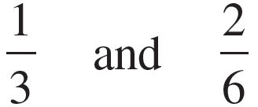
A Definition for Rational Numbers
For a moment, forget what you know about fractional arithmetic and look at the numbers
as symbols. Considered as symbolic expressions, these appear quite different. In fact, if they were written as ordered pairs (1, 3) and (2, 6) they would be different.

Slide 40
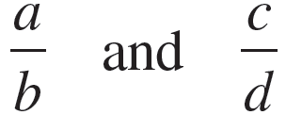
A Definition for Rational Numbers
The fact that we regard them as “the same” is a specific instance of our general agreement to regard any two numbers
as equal provided the cross products are equal; in other words, if, and only if, ad = bc.

Slide 41
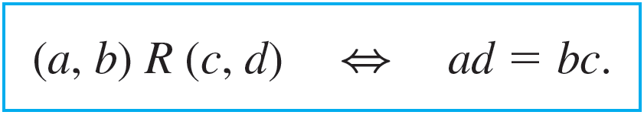
Example 8.3.12 – Rational Numbers Are Really Equivalence Classes
Let A be the set of all ordered pairs of integers for which the second element of the pair is nonzero. Symbolically:
A = Z × (Z − {0}).
Define a relation R on A as follows: For all pairs (a, b) and (c, d) in A,

Slide 42
Example 8.3.12 – Rational Numbers Are Really Equivalence Classes
continued
The fact is that R is an equivalence relation.
a. Prove that R is transitive.
b. Describe the distinct equivalence classes of R.

Slide 43
Example 8.3.12 – Solution
a. By definition of R,
(1) ad = bc and (2) cf = de.
Since the second elements of all ordered pairs in A are nonzero, b ≠ 0, d ≠ 0, and f ≠ 0. Multiply both sides of equation (1) by f and both sides of equation (2) by b to obtain
(1′) adf = bcf and (2′) bcf = bde.

Slide 44
Example 8.3.12 – Solution
continued
Because both equal bcf,
adf = bde,
and, since d ≠ 0, it follows from the cancellation law for multiplication that
af = be.
Hence, by definition of R, (a, b) R (e, f).

Slide 45
Example 8.3.12 – Solution
continued
b. There is one equivalence class for each distinct rational number. Each equivalence class consists of all ordered pairs (a, b) that, if written as fractions a ∕ b, would equal each other.
The reason is that the condition for two rational numbers to be equal is the same as the condition for two ordered pairs to be related.

Slide 46

Example 8.3.12 – Solution
continued
For instance, the class of (1, 2) is
[(1, 2)] = {(1, 2), (−1, −2), (2, 4), (−2, −4), (3, 6), (−3, −6), ... }
since
and so forth.

